Slide 1

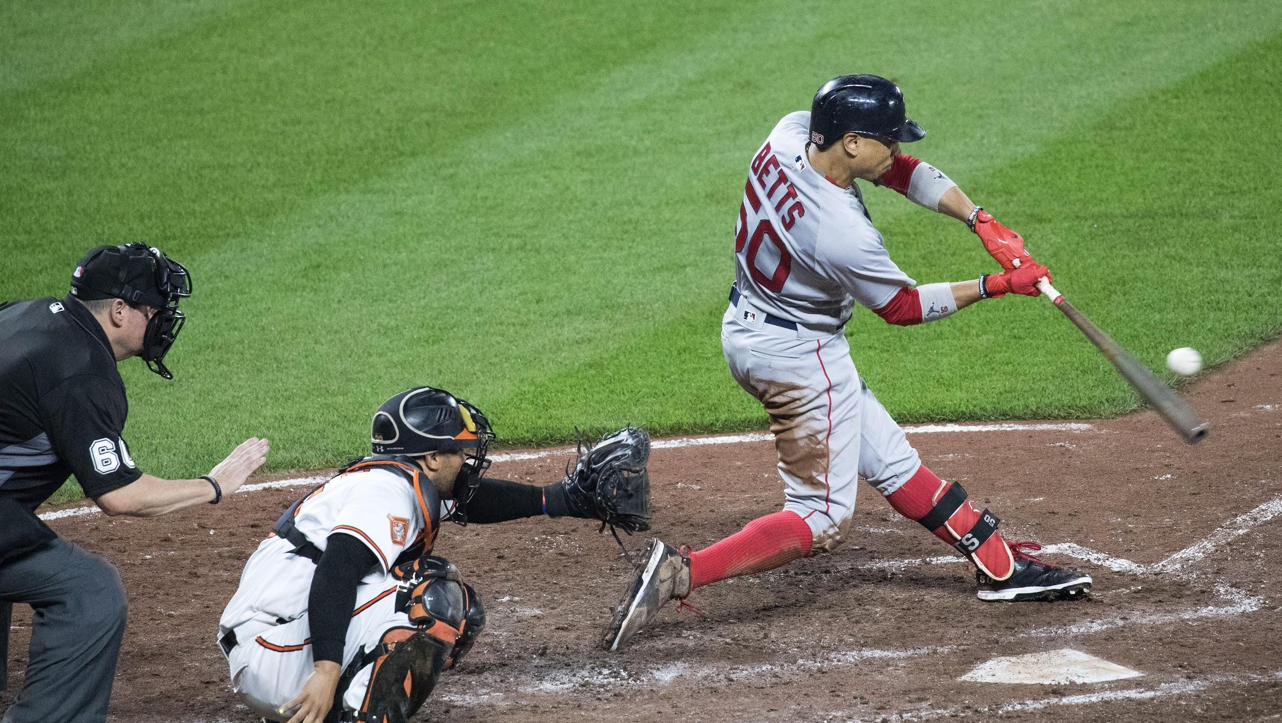


Baseball Draft Prediction
Going back from 2000 can we discover/predict if a first round pick will help their team make playoffs, or how long the player will be in the MLB!
Notes:
Bethany

Slide 2

First Round Draft Pick Prediction
The purpose of this analysis is to see if there is a correlation between longevity and the draft round pick of a major league baseball player.
Notes:
Bethany

Slide 3

Questions
Is there a correlation between first round draft picks and the team making it to playoffs?
Is there a correlation between first round draft picks and longevity in the MLB?
Notes:
Bethany

Slide 4

Stats included
Overall draft pick
Initial signing salary/bonus
Average annual salary over the length of player's career
Batting and Pitching stats for their career
What awards did the players accumulate?
How many games did they play?
If the average MLB player’s career is 4-6 years, how does 1st and 2nd round players compare?
What is their overall batting average?
What is their length per initial team they were drafted?
Notes:
Lucy

Slide 5
Source of Data
We used two data sources from Baseball Reference (link) and Kaggle (link).
Baseball Reference was used because it gives statistics on every major league baseball player since the inception of the MLB in 1876. The site has statistics on first round draft picks dating back to 1965, that includes the player, the selecting team, position and signing bonus (link). The site also shows each rookie of the year dating back to 1947. This includes their team, league, and batting statistics (link).
Kaggle was used to gather sorted data files for teams, players, career lengths, and playoff information.
Notes:
Joshua

Slide 6
Extract
We were tasked with finding usable data from Baseball Reference and Kaggle.
Multiple CSV files were downloaded that included data for:
First round draft picks for the years 2000 – 2015
Team Names and their franchise ID
Career lengths for all players from 2000 – 2015
Post – season teams from 2000 – 2015
MLB divisions by league
Notes:
Joshua

Slide 7
First year overall stats
Round Pick
Player performance
Playoffs
Salary Bonus
Notes:
Joshua

Slide 8
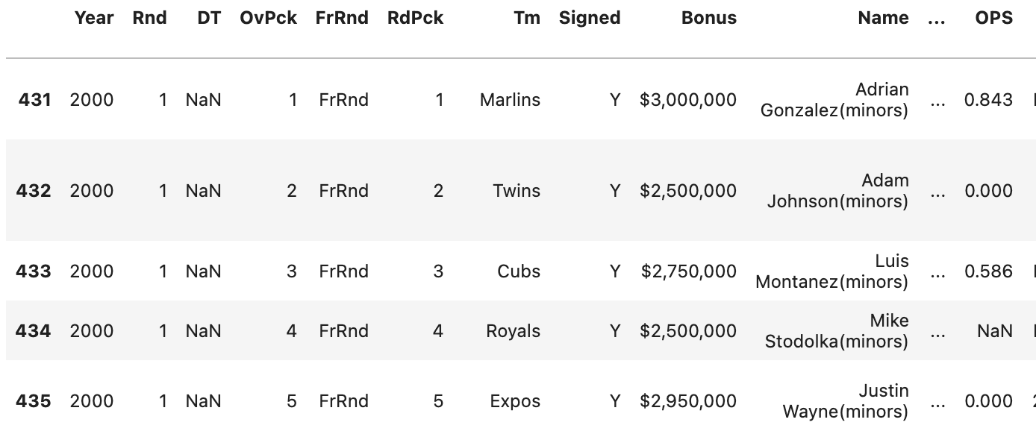
Transform & Load
Using glob and OS, a function was created that looped through all first-round draft CSVs and merged them into one Data Frame.
Notes:
Joshua

Slide 9
Cleaning the Data
Concerns:
Removing unnecessary columns (‘FrRnd’, ‘DT’, ‘OvPck’)
Changing data types (Bonus)
Cleaning up player names using RegEx
Cleaning up team franchise ids
Filling Null columns/rows
Notes:
Danielle
After merging out csvs, the data was inspected and the following issues were notes.
There were columns that were not needed (FrRnd, DT, OvPck)
The bonus column was in a string format but needed to be in int format
The players names included additional info and we needed to get just the name by itself
The franchise IDs needed to matched to the correct team
Null values needed to be dealt with

Slide 10
Null Columns
One issue we ran into was how many null columns were present because many players were missing player stats.
Dropping any rows with null values left us with limited data.
We decided to fill in null values with 0.
Notes:
Danielle
After speaking as a team, we decided to fill null values with 0. These null values were all located in the player stats. A blank value represented no values for that stat, which could be represented by a 0
Deleting all rows with null values left us with very little data

Slide 11
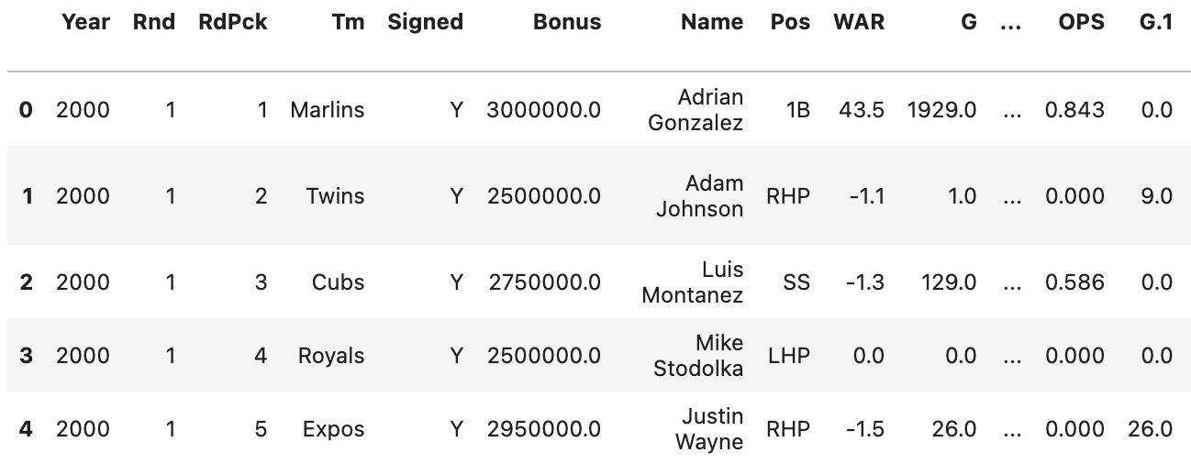
Before
After
Notes:
Danielle

Slide 12

Data Exploration and Analysis
Notes:
Bethany

Slide 13
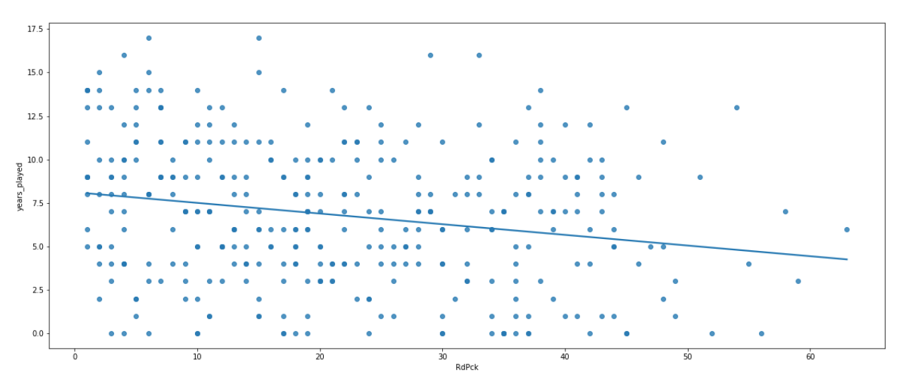
Correlation between Round pick and years played
Using a linear regression model, there is a weak negative correlation between when a player who is picked in the first round and the length of their careers.
Notes:
Bethany

Slide 14
Dashboard
Notes:
Lucy

Slide 15
Can we predict if a team will make post-season based on their first-round pick choice(s)?
Notes:
Danielle

Slide 16
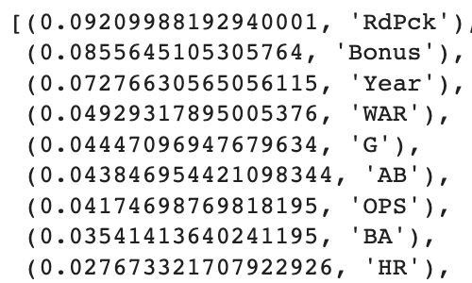
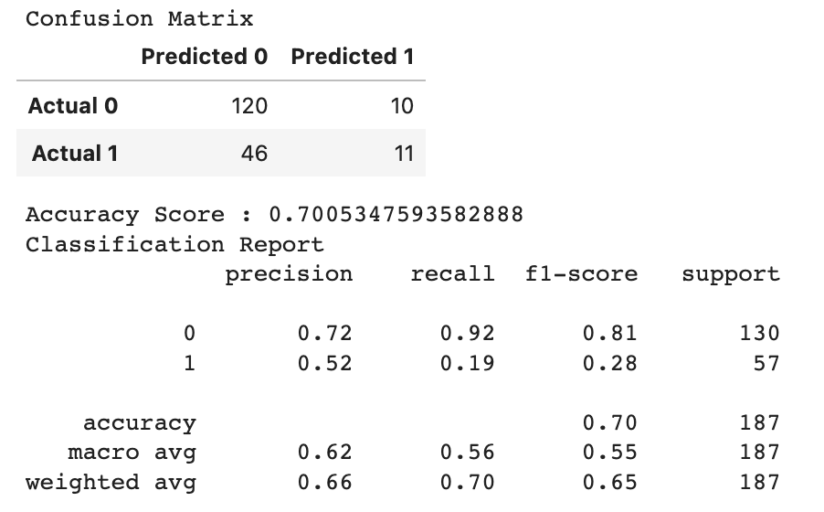
Random Forest Model
Top Features
Notes:
Danielle
Chose to use Random Forest originally since we were dealing with binary classifies
Out data is also tabular (csvs turned into Dataframes) and non linear
We were also curious in being able to rank our input features
Results from the Random Forest Model

Slide 17
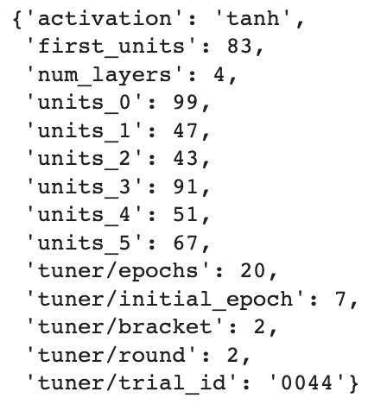
Deep Learning Model
Using Keras Tuner…
Loss: 0.580104
Accuracy: 0.770053
Notes:
Danielle
Results from Deep Learning Model using Keras Tuner. Better Accuracy Overall.

Slide 18
Further Investigation
Deeper analysis of playoff performance based on the top features from the Random Forest Model.
Potential difference in predictive outcome based on player position (pitcher vs fielder).
Are there additional features that could be added to improve our model(s)?
Could this be a resource for fantasy baseball or teams to use in their draft selection?
Is there a correlation between their round pick and WAR (overall performance) stat?
Notes:
Danielle
Further questions from our machine learning model.

Slide 19
Can we predict if a team will make post-season based on their first-round pick choice(s)?
Notes:
Danielle
Using data that included the career lengths of all the players that were picked in the first round from 2000 - 2015

Slide 20
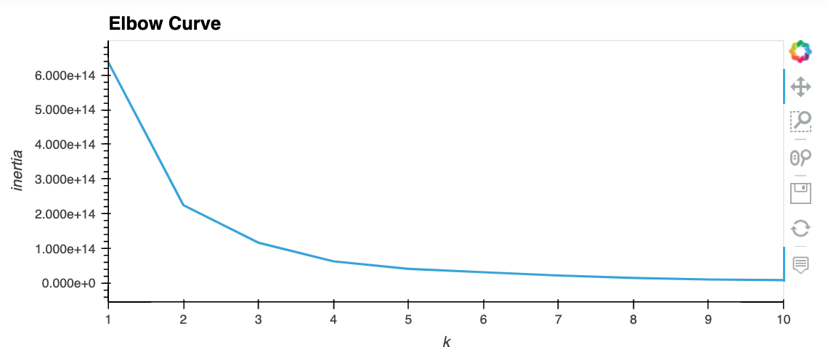
K- Means Elbow Curve
Notes:
Danielle
Initial K-means elbow curve.
Chose to test 3 and 4 clusters.

Slide 21
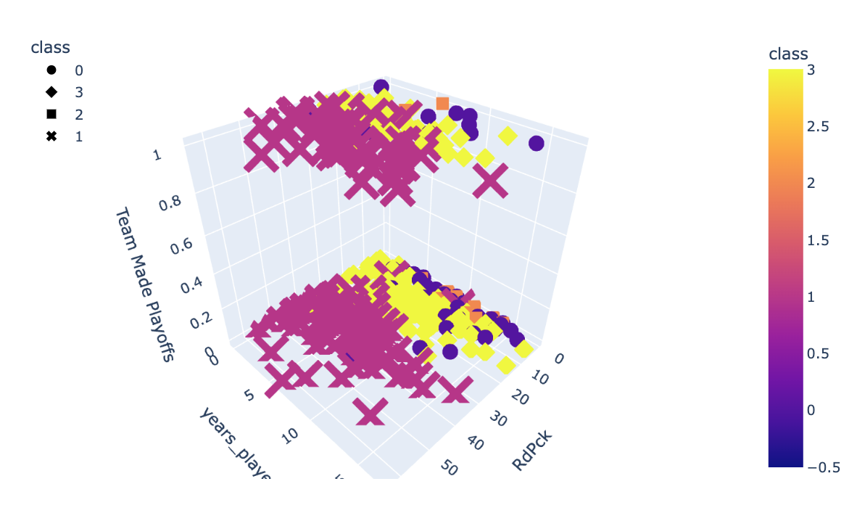
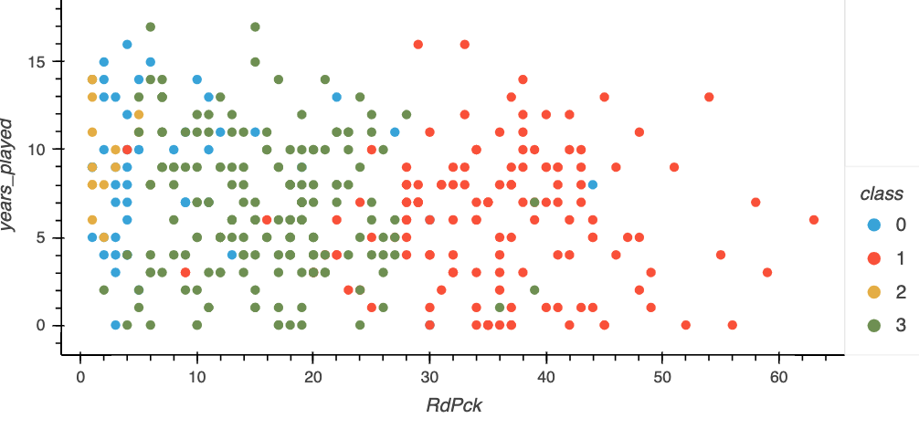
Results with 4 clusters
Notes:
Danielle
Best results with 4 clusters.

Slide 22
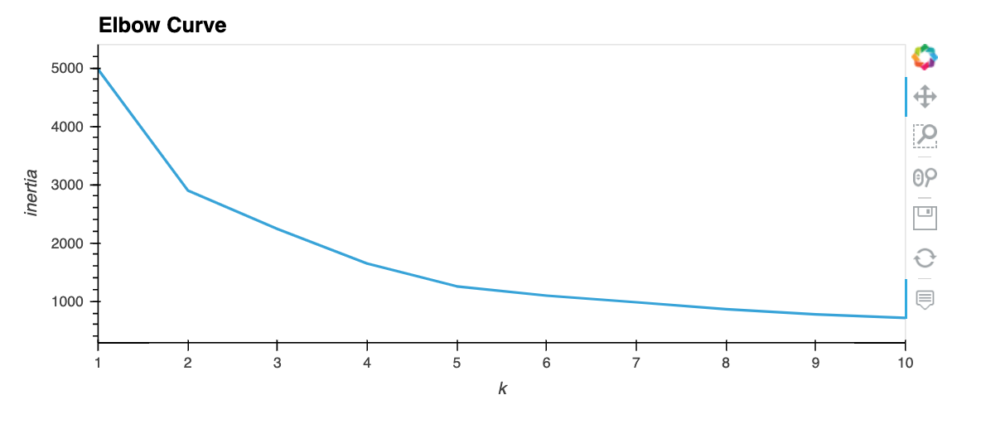
K-Means with PCA dimensionality reductions
Notes:
Danielle
Our data included multiple dimensions.
Decided to rerun our K-Means but using PCA first to reduce the amount of dimensions
K-Means with PCA
We chose to use 3 PCA dimensions
5 clusters

Slide 23
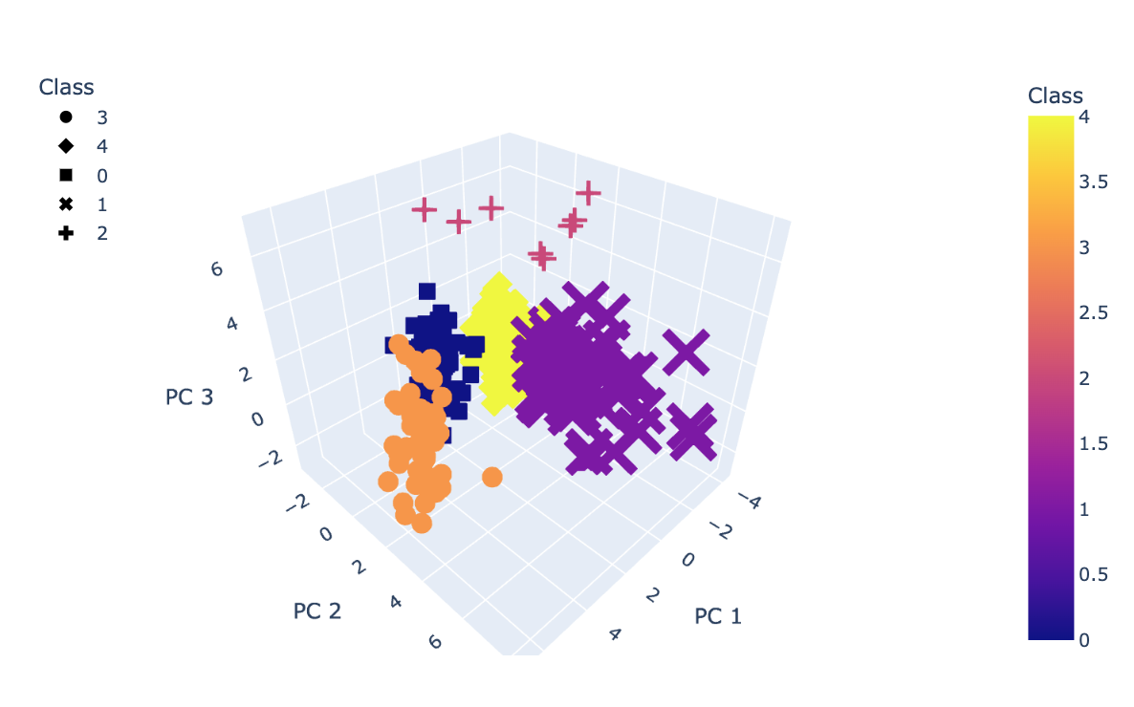
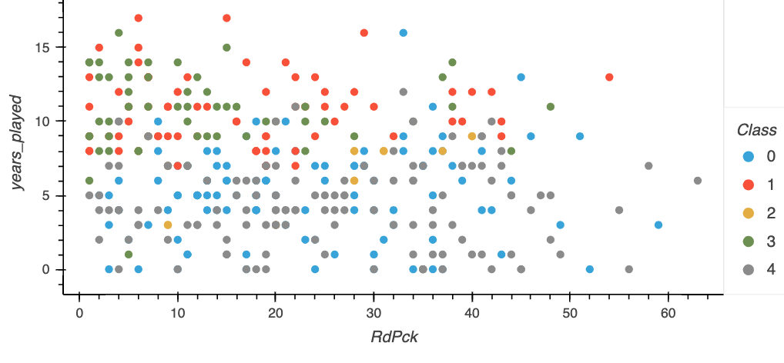
Results with PCA and 5 clusters
Notes:
Danielle
Much clearer groups

Slide 24
Further Investigation
Determining why career length data was grouped the way it was.
Hypothesis:
Career Stats and/or player position
Notes:
Danielle
Further investigation

Slide 25
Tools Used
SQL
Baseball-reference.com
Kaggle.com
Python & Pandas
HTML
Tableau

Slide 26


Contact
Danielle Silvaggio
https://github.com/dsilvaggio
Lucy Mccanna
https://github.com/lucymccanna
Bethany Knowlton
https://github.com/bknowlton2401
Joshua Braun
https://github.com/jtbraun8

